Slide 1



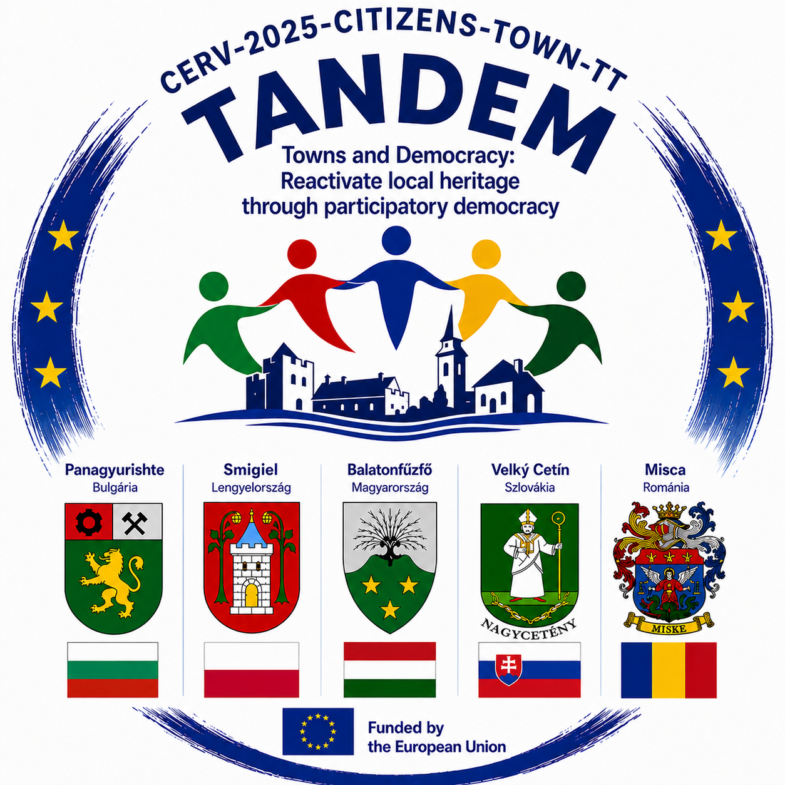
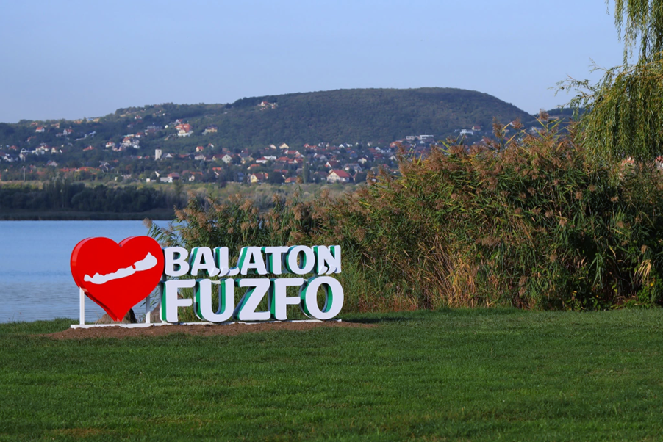
BALATONFŰZFŐ – LOCAL GOOD PRACTICES
Cultural Heritage as a Community Resource
TANDEM: CITIES AND DEMOCRACY
REVIVING LOCAL HERITAGE THROUGH PARTICIPATORY DEMOCRACY

Slide 2

Why is TANDEM important for Balatonfűzfő?
I.
Balatonfűzfő is a small-town community where its industrial past, the Lake Balaton environment, and its civic and cultural life together shape the local identity.
The aim of TANDEM is not only to preserve cultural heritage, but also to use it as a tool for community participation and democratic dialogue.
As the lead partner in the project, Balatonfűzfő brings its experience in community-based cultural programmes and international cooperation.
Following the meeting in Panagyurishte, local examples should be presented not simply as a list of events, but as transferable methods and approaches.
TANDEM – Balatonfűzfő | Good Practices

Slide 3
Balatonfűzfő’s Heritage Profile
II.
Industrial heritage and factory culture – a defining part of the town’s history.
The Lake Balaton and natural environment – an important backdrop to local identity and community life.
Local cultural life – cultural centre, library, community event spaces, tourist centre, and a wide range of cultural and community programmes.
Civil society and community organisations – numerous cultural, sports, senior citizens’, heritage-preservation and community organisations.
International cooperation – town-twinning partnerships and the TANDEM project partnership.
TANDEM – Balatonfűzfő | Good Practices

Slide 4
Good Practice: Cooperation between Civil Society and the Municipality
III.
In Balatonfűzfő, alongside the municipality, a wide range of civil society organisations are active, taking on cultural, community, sports and social responsibilities.
Supporting civil society organisations creates opportunities for local communities to initiate and implement their own initiatives.
A jó gyakorlat lényege: az önkormányzat ne kizárólag programgazda legyen, hanem partner és támogató.
TANDEM lesson: cultural heritage becomes a community resource when local people are not only consumers, but also active participants in shaping and creating programmes.
TANDEM – Balatonfűzfő | Good Practices

Slide 5
Good Practice: “Community and Industrial Heritage”
IV.
The town’s industrial past is not merely a matter of industrial history; it also carries personal memories, family stories and a sense of community identity.
The “Community and Industrial Heritage – 100 Years of Heritage in Balatonfűzfő” programme is a good example of how local history can be transformed into a community-based topic through a cultural event.
The approach can be further developed through oral history, the collection of photographs and objects, digital storytelling, and the creation of a local memory map.
TANDEM value: through personal stories, heritage becomes accessible and meaningful to several generations.
TANDEM – Balatonfűzfő | Good Practices

Slide 6
Good Practice: Cultural Programmes as Community Platforms
V.
The cultural programmes of the Vágfalvi Ottó Cultural Centre, Library and Tourism Centre create opportunities for people to meet and connect.
Exhibitions, lectures, music and community programmes can bring together different generations and people with diverse interests.
Programmes become genuine participatory practices when community involvement is incorporated from the planning stage onwards.
Development direction: “What would we like to preserve?” – regular community discussions about local heritage.
TANDEM – Balatonfűzfő | Good Practices

Slide 7

Good Practice: Civil Society Diversity and Volunteering
VI.
The civil society organisations of the town represent a wide range of local knowledge, experience and networks.
Particularly valuable are those communities that keep a particular generation, sport or cultural field, or local tradition alive.
A key element of participatory heritage governance is connecting the knowledge and experience of civil society organisations with municipal decision-making.
TANDEM message: “THE EXPERTS ON LOCAL HERITAGE DO NOT ONLY WORK IN INSTITUTIONS – THEY ARE ALSO PART OF THE COMMUNITY.”
TANDEM – Balatonfűzfő | Good Practices

Slide 8
What Can We Learn in Panagyurishte?
VII.
It is useful to present each good practice through four key questions:
  What do we do? – the specific programme or method.
  Who do we involve? – the municipality, institutions, civil society organisations, young people, older people, etc.
  What changes? – knowledge, cooperation, trust and community identity.
  Can it be transferred elsewhere? – costs, resources, necessary partners and time requirements.
This approach is directly aligned with the objective of the Panagyurishte workshop: to jointly develop the first professional version of the Good Practices Collection.
TANDEM – Balatonfűzfő | Good Practices

Slide 9
Three Balatonfűzfő Good Practices – In Brief
VIII.
Civil society–municipality partnership: supporting and jointly implementing local initiatives.
Community reinterpretation of industrial heritage: industrial heritage, personal stories, collective memory and local identity.
Cultural institution as a community platform: programmes and meeting places that connect generations and local stakeholders.
Common element: local heritage is alive when people have a personal connection to it.
TANDEM – Balatonfűzfő | Good Practices

Slide 10
Next Step: Balatonfűzfő 2027
IX.
The second TANDEM event will take place in Balatonfűzfő, 4–6 June 2027.
Focus: participatory heritage governance, intergenerational cooperation and community co-creation.
Planned methods: digital storytelling, QR codes, videos, heritage cafés, and joint activities involving young and older generations.
Objective: to test and further develop the good practices collected in Panagyurishte in a real local context.
Outcome: contribution to the Heritage Participatory Toolkit.
TANDEM – Balatonfűzfő | Good Practices

Slide 11
Proposed Method for the Good Practices Collection
X.
Each good practice should be presented as a one-page “card” containing.
1. Title and short description
2. Location and implementing partner(s)
3. What local problem does it address?
4. Who participates?
5. What method is applied?
6. What results have been achieved?
7. What was the biggest challenge?
8. What can be transferred to another municipality?
9. Required time, human and financial resources
10. Photo/link/further information
TANDEM – Balatonfűzfő | Good Practices

Slide 12
Balatonfűzfő’s Message in One Sentence
XI.
„Cultural heritage is not only what we preserve from the past,
but also what we reinterpret and pass on together.”
Balatonfűzfő’s Objective within TANDEM:
To connect local stories, institutions and civil society communities in such a way that heritage becomes an active part of both present-day community life and future cooperation.
TANDEM – Balatonfűzfő | Good Practices

Slide 13
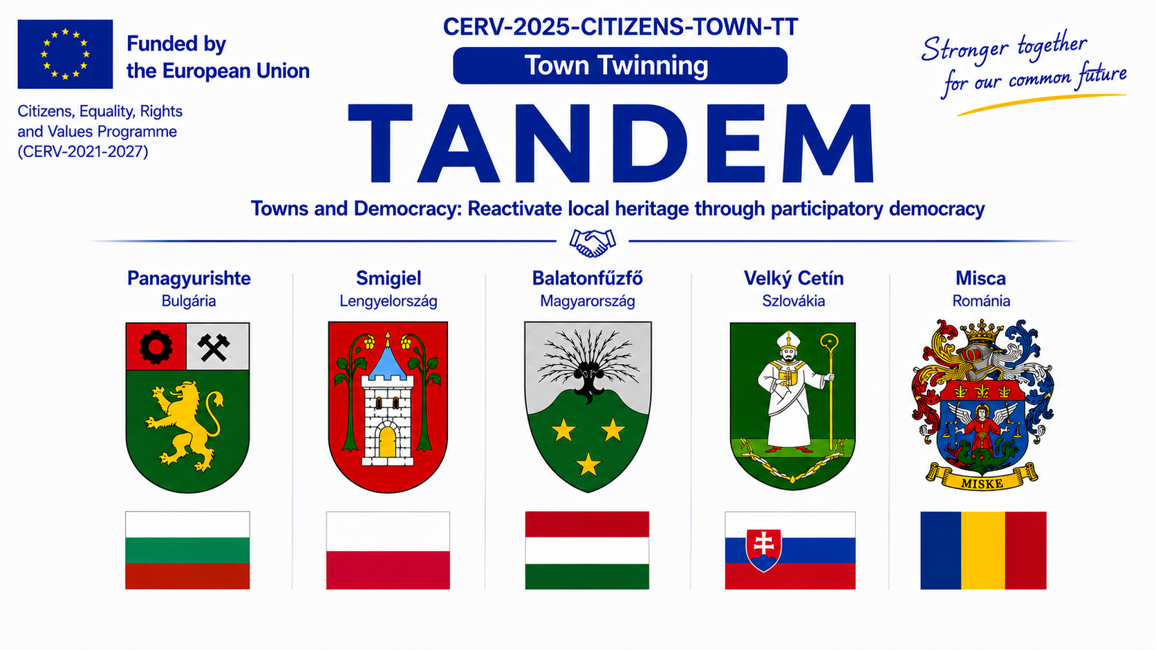
Thank you for your attention!
TANDEM – Balatonfűzfő | Good Practices

Slide 14
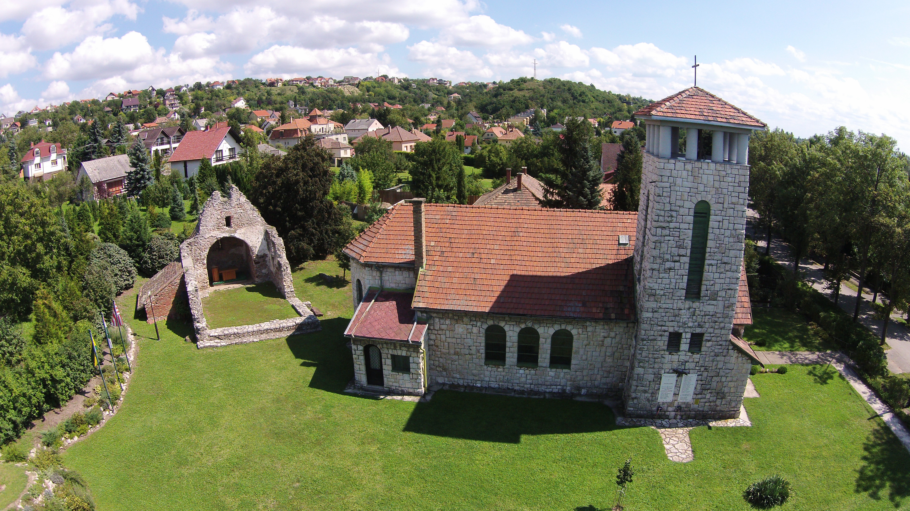
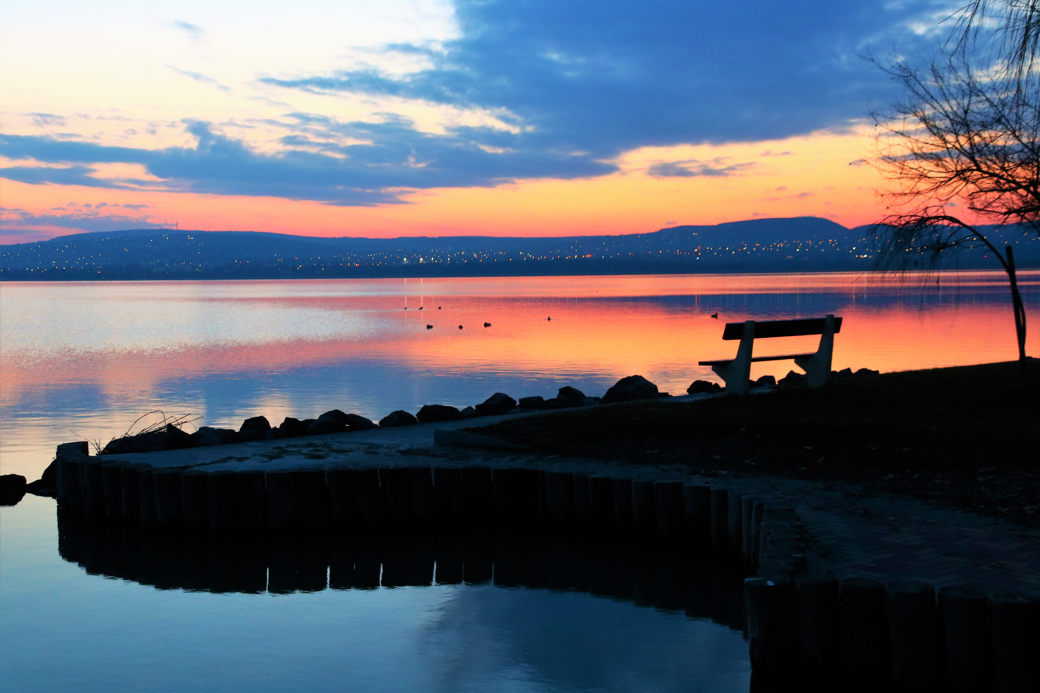
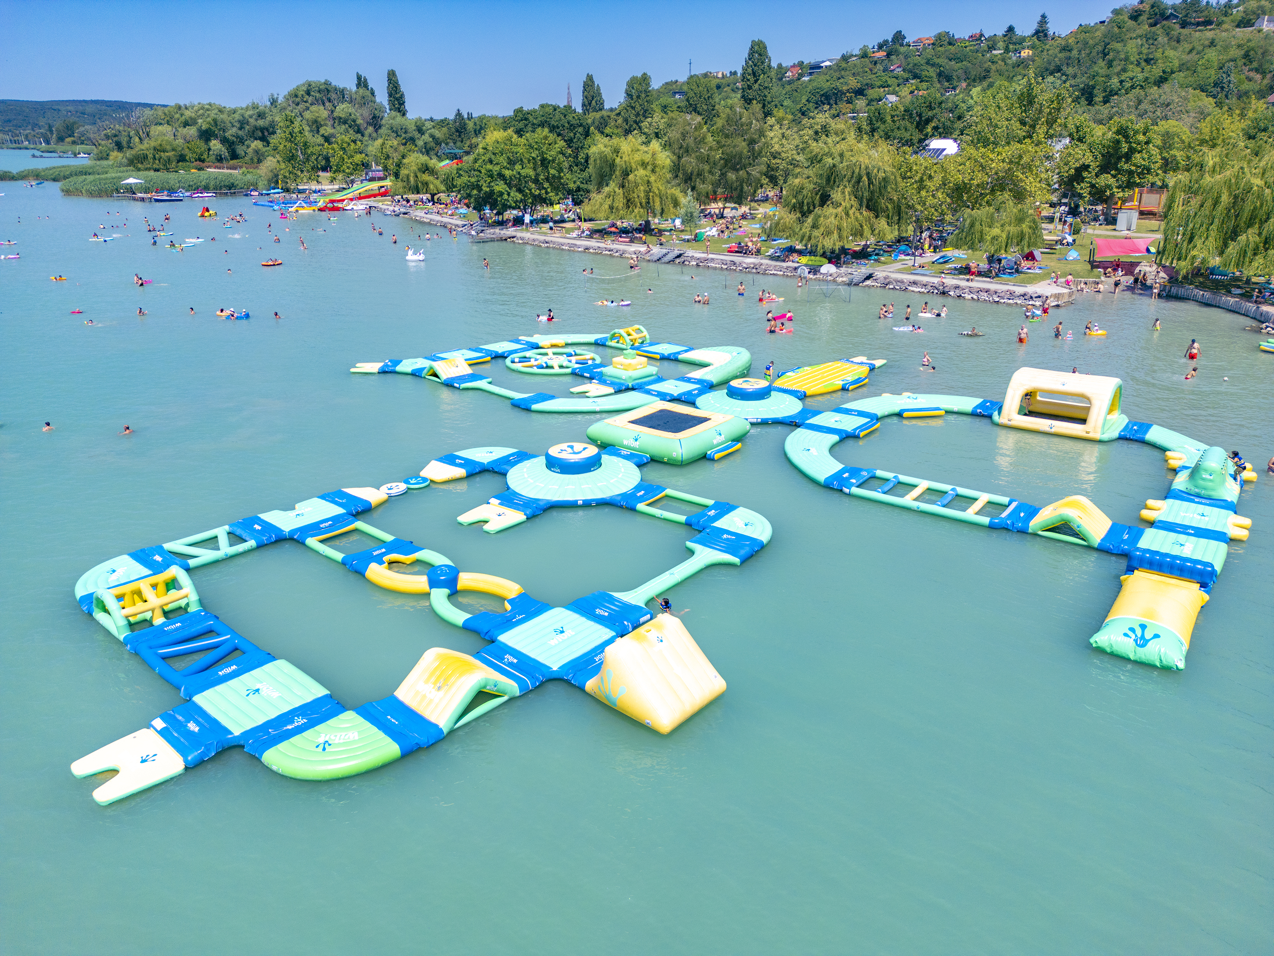
We look forward to meeting you soon in Balatonfűzfő!
TANDEM – Balatonfűzfő | Good Practices

